Slide 1

New York City Airbnb
Computational Thinking Project
Alice Jiang
Kaidi Meng

Slide 2
Introduction
Packages
“AB_NYC_2019.csv”
from Kaggle
16 columns (host_name, neighbourhood, price, etc.)
Most popular neighbourhood?
Number of Reviews vs. Price
Which Room Type?
Busiest Host in NYC?
panda
matplotlib

Slide 3
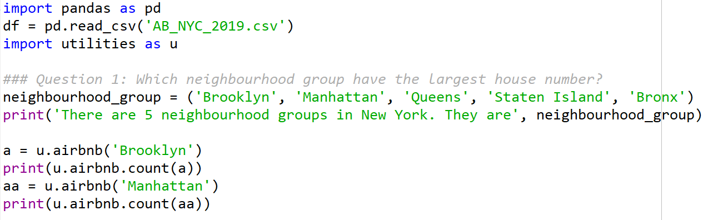
Main Program - part 1
Most popular neighbourhood?

Slide 4
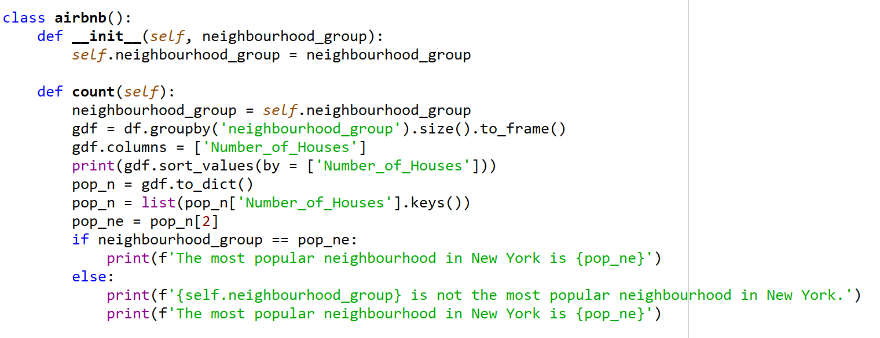
Functions -part 1
Most popular neighbourhood?

Slide 5
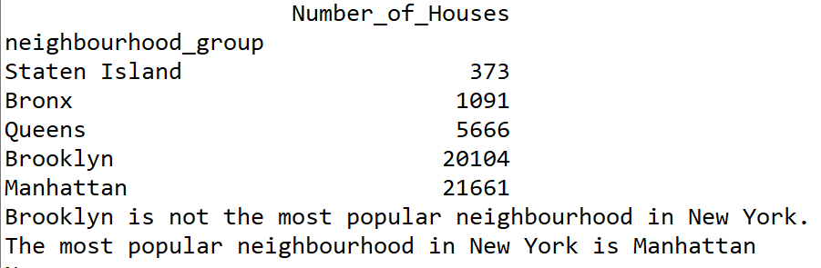
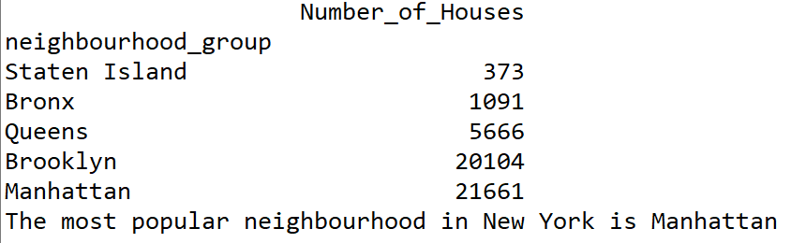
Output

Slide 6
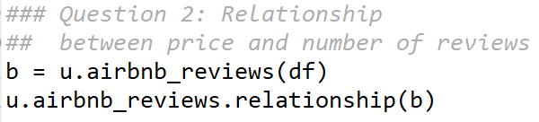
Main Program - part 2
Number of Reviews vs. Price
Notes:
the higher the number of reviews, the the lower the airbnb price

Slide 7
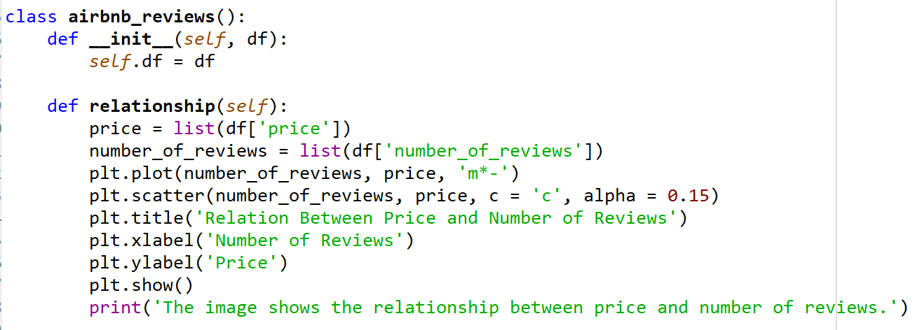
Functions - part 2
Number of Reviews vs. Price

Slide 8
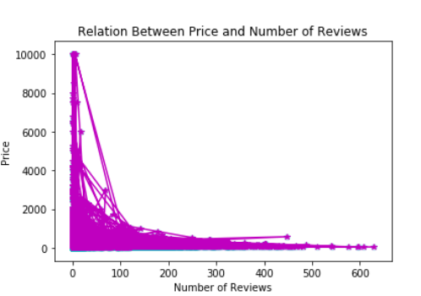
Output

Slide 9
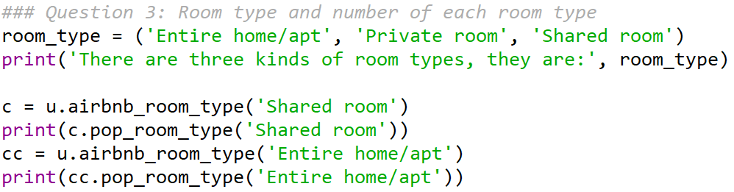
Main Program - part 3
Which Room Type?

Slide 10
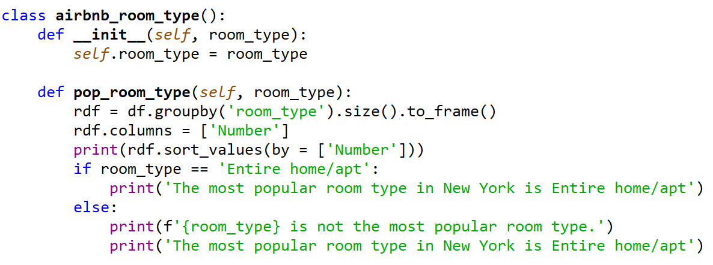
Functions - part 3
Which Room Type?

Slide 11
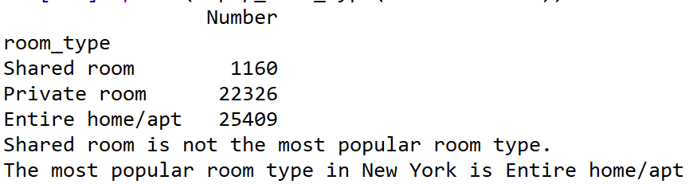
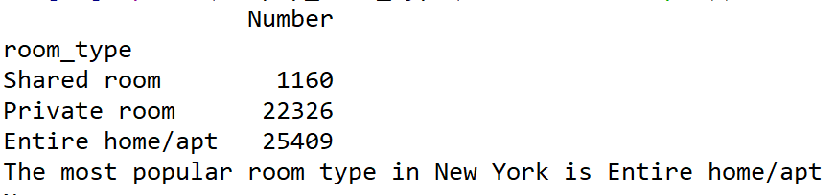
Output

Slide 12
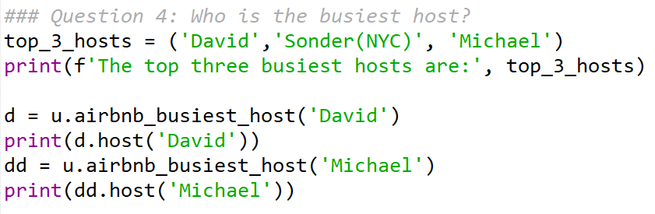
Main Program - part 4
Busiest Host in NYC?

Slide 13
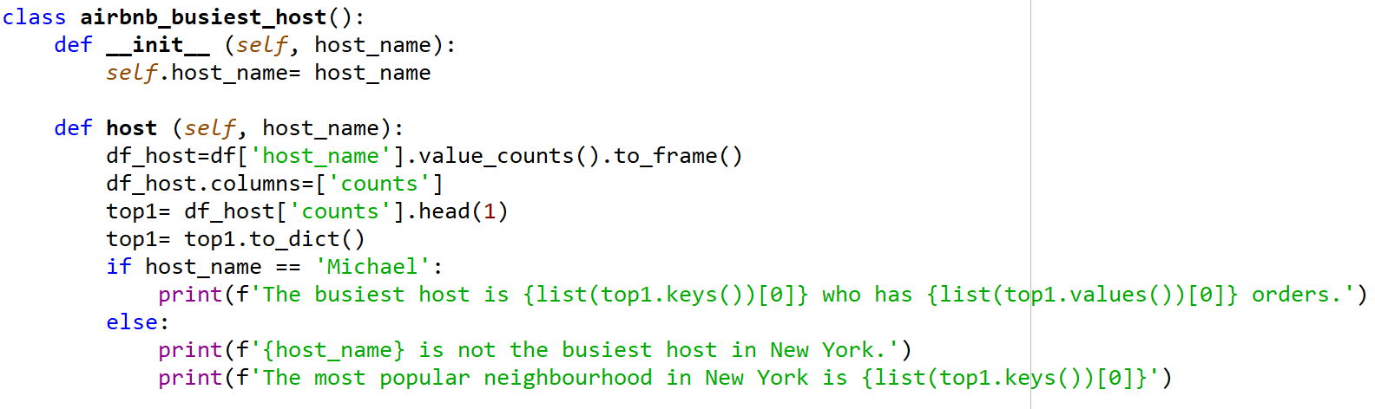
Functions - part 4
Busiest Host in NYC?

Slide 14
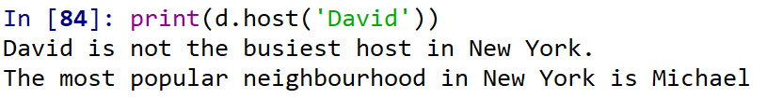
Output

Slide 15
THANK YOU

